Slide 1

2019 Gear Up
1040 Seminar
Welcome!!
Michael A. Gordon, CPA
Not Your Basic Bean Counter

Slide 2

2019 Gear Up
1040 Seminar
Welcome!!
Michael A. Gordon, CPA
Not Your Basic Bean Counter

Slide 3

A Research Resource

Slide 4
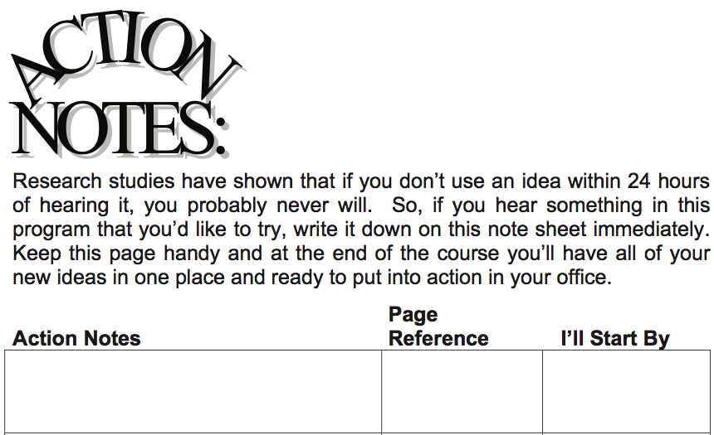
Things Learned Here Today!

Slide 5


Questions??

Slide 6

Please be courteous…
Please turn your cell phone off (or to silent mode), and take any telephone calls out in the corridor.
Thank you,
Your friendly neighbor

Slide 7
Other Items
Breaks
Lunch
Emailing the Gear Up instructors
Don’t distract those near you

Slide 9
Chapter 21 - Schedule C
Still The Most Popular Way To Do Business
325
Presented by:
Michael A. Gordon, CPA
Not Your Basic Bean Counter
Gear Up Tax Seminars

Slide 10
Chances of Being Audited – 2016 Fiscal Year
Chapter 21 Sole Proprietor – Schedule C
All Tax Returns .6%
All individual returns .7%
Schedule C $100-$200K 2.2%
Schedule C $200K+ 1.9%
C Corporations 1.1%
S Corporations .3%
Partnerships .4%
Source: IRS Data Book 2016

Slide 11
Advantages and Disadvantages
Chapter 21 Sole Proprietor – Schedule C
Advantages
QBID !!!!!!!!!!!!!! Yay !!!!!!!!
Simplicity
  No balance sheet required (WARNING)
  Easy to start and easy to stop doing business
  No payroll reporting for owner
Single level tax
Disadvantages
All income subject to self-employment tax
No limit of liability

Slide 12
Who Must File Schedule C
Chapter 21 Sole Proprietor – Schedule C
All Trades or Businesses with one owner
Separate Schedule C for each business
Single Member LLC
Husband and Wife Joint Venture (the very misunderstood QJV rules)…page 326, item F.

Slide 13
What’s New
Chapter 21 Sole Proprietor – Schedule C
Method of accounting Pg. 331, item C
Hobby-related expenses Pg. 330, item H
Meals and entertainment Pg. 337, item K
Excess business losses Chapter 22
The “sharing” economy Pg. 339, item VII
The “marijuana” economy Pg. 341, item VIII

Slide 14
What’s New
Chapter 21 Sole Proprietor – Schedule C
At this point, based on time remaining, we will venture into the book and cover some “other” issues…see next slides.

Slide 15
Statutory Employees…pg. 326, Item E
Chapter 21 Sole Proprietor – Schedule C
Time to re-learn these rules.
They file a Schedule C.
This will/may become a BIG deal for the QBID…may have some W-2’s that are NOT checking the box!
See New Case….pg. 326

Slide 16
Qualified Joint Venture…pg. 326, Item F
Chapter 21 Sole Proprietor – Schedule C
IRC 761(f)….why did Congress enact this set of rules? Hint: gender issues.
Page 326, item F covers the rules. Pay special attention to F.4.b. and F.4.c.
CYA issues….my worksheets.
WARNING: Why do we care? Because of the onerous failure to file penalties.

Slide 17
Qualified Joint Venture…pg. 326, Item F
Chapter 21 Sole Proprietor – Schedule C
WARNING: When a qualified QJV exists, you can no longer file ONE Schedule C with both names on it and bifurcate the net income over to 2 SE Forms.
You must EITHER file a 1065 OR file 2 separate Schedule C’s.
What’s the big deal? Your client will make YOU pay the assessed late filing penalties!

Slide 18
Material Participation – Reg. 1.469-5T
Chapter 21 Sole Proprietor – Schedule C
311
More than 500 hours
Substantially all participation (including hours spent by non-owners)
More than100 hours and as much as anyone else (including non-owners)
Significant participation activity
Materially participated 5 out of last ten years
Personal service activity and materially participated any 3 prior years
Based on facts and circumstances

Slide 19
Material Participation – Reg. 1.469-5T
Chapter 21 Sole Proprietor – Schedule C
311
I highly recommend reading this entire regulation regularly with your staff.
We have a binder on each desk with all of this and more.
www.mikegordoncpa.net

Slide 20
Material Participation – Reg. 1.469-5T
Chapter 21 Sole Proprietor – Schedule C
Questions:
Can a Schedule C business be “passive”?
YES.
See page 332, Item D.
If it shows income, is it still subject to SE?
YES.
See page 332, Item D.1.

Slide 21

Material Participation – Reg. 1.469-5T
Chapter 21 Sole Proprietor – Schedule C
IRC
469
IRC
1402
The mythical bridge between IRC 469 and IRC 1402
THERE AIN’T NO BRIDGE!!!

Slide 22
Material Participation
Chapter 21 Sole Proprietor – Schedule C
Real errors I have caught…
New client comes to you. You review prior year return(s).
This client has had a Schedule C hardware store for 25 years.
Schedule C consistently shows LARGE net income ($100,000+)
Client also has Schedule E rentals showing losses ($100,000)

Slide 23
Material Participation
Chapter 21 Sole Proprietor – Schedule C
Real errors I have caught…
You see Form 8582 showing the rental losses as suspended.
You go over the 7 tests for material participation with the client and learn that he has not “materially participated” for 6 years.

Slide 24

Material Participation
Chapter 21 Sole Proprietor – Schedule C
This is an incorrectly prepared income tax return!!
Are you shocked!!!!

Slide 25
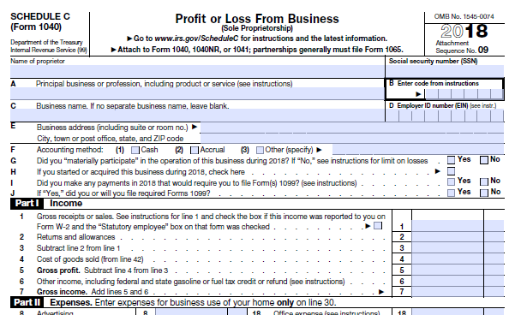
Chapter 21 Sole Proprietor – Schedule C
335-336
Cost of Good Sold

Slide 26
Chapter 21 Sole Proprietor – Schedule C
Cost of Good Sold
We may need to help our clients take a meaningful physical inventory count
How? When? Physical count? Retail method? Material items only? Cycle counts?
What about a perpetual inventory system?

Slide 27

Chapter 21 Sole Proprietor – Schedule C
Cost of Good Sold
Client asks you…..
“So, how much should the ending inventory figure be?”
What do you do?!!

Slide 28
Chapter 21 Sole Proprietor – Schedule C
Cost of Good Sold
Calculate COGS% each year and keep the running total somewhere so you can look at it annually with the client.
Problem 1: Wild fluctuations. Better get an explanation and document it in the workpapers…..CYA.
Problem 2: Too low or too high. Better get an explanation and document it in the workpapers…CYA.

Slide 29
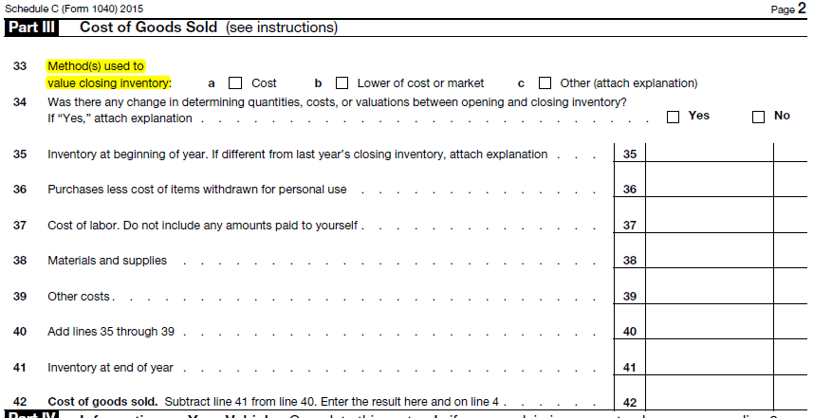
Cost of Good Sold
Chapter 21 Sole Proprietor – Schedule C
?

Slide 30

Ordinary and Necessary?
Appropriate and Helpful?
Chapter 21 Sole Proprietor – Schedule C
Haircuts?
Guitar lessons?
Don’t Laugh!!!

Slide 31
Chapter 21 Sole Proprietor – Schedule C
346
Employing Family Members
Don’t get cute
Make it real
Mean, nasty IRS agent will cremate your kid under questioning!
Do NOT forget the I-9, W-4, W-2 and any other forms regularly used for payroll purposes

Slide 32
Polling Question
I have been attending the Gear Up 1040 Individual Tax seminars for ________.
This is my first one!
One to ten years
Ten to twenty years
Long enough to remember when it was Nuts and Bolts!
Notes:
INSTRUCTOR – INTRODUCTORY – ELEMENT OF ENGAGMENT – Perform informal poll (e.g. show of hands) by inquiring of participants – see slide content.

Slide 33
END OF CHAPTER!!

Slide 34
Chapter 22
Excess Business and Net Operating Losses
351
Presented by:
Michael A. Gordon, CPA
Not Your Basic Bean Counter
Gear Up Tax Seminars

Slide 35
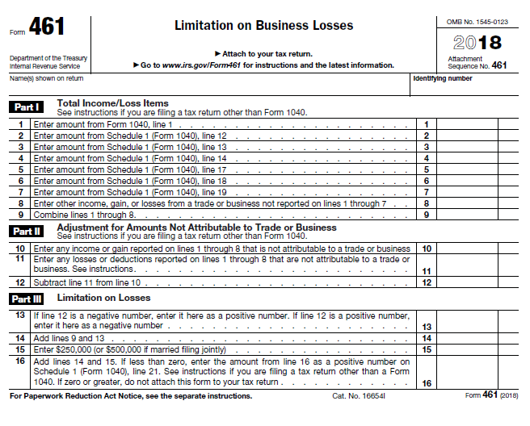
Chapter 22
Excess Business Losses
New form for 2018. See Form on page 353.
See page 352, CAUTION box

Slide 36
Chapter 22
Excess Business Losses
Pay attention to (on page 351):
Item B.2…..These are the 2018 threshold amounts
Item C……..These are the new 2019 threshold amounts
The TIP Box…..Second paragraph…for MFJ returns

Slide 37
Chapter 22
Excess Business Losses
Example (on bottom of page 352):
 | 2018 | 2019
Income from T//B | 200,000 | 120,000
Deductions from T/B | -500,000 | -330,000
Loss | -300,000 | -210,000
Threshold for SINGLE | 250,000 | NEW 255,000
Excess Business Loss | -50,000 | None
NOTE: The 2018 $50,000 EBL becomes an NOL and does NOT impact the 2019 calculation of EBL.

Slide 38
Chapter 22
Excess Business Losses
Example 2 (on bottom of page 353):
 | 2018 | 2019
Income from T//B | -
Deductions from T/B | -
Loss | -1,150000
Threshold for SINGLE | 500,000
Excess Business Loss | -650,000
NOTE: The 2018 $650,000 EBL becomes an NOL
c/o to 2019

Slide 39
Chapter 22
Excess Business Losses
IMPORTANT – Interaction with QBID? See page 354, Caution Box
We will continue to have to apply the Passive Loss rules BEFORE looking at the IRC 461 limitation on “excess business losses”.
This means that if an activity is passive, it’s loss will already be limited under IRC 469 and there will be no need to apply the 461 rules.

Slide 40
Chapter 22
Excess Business Losses
IMPORTANT – Coordination with IRC 469…see page 354, Item J.
We will continue to have to apply the Passive Loss rules BEFORE looking at the IRC 461 limitation on “excess business losses”.
This means that if an activity is passive, it’s loss will already be limited under IRC 469 and there will be no need to apply the 461 rules.

Slide 41

Chapter 22
Excess Business Losses
So, this really means that we now have added a 4th level of loss limitations….
Basis
At-Risk
Passive
Excess Business Loss

Slide 42
Chapter 22
Excess Business Losses
K-1 Reporting
1065 K-1, will use line 20, code AF
1120S K-1 will use line 17, code AC

Slide 43
Chapter 22
Excess Business Losses
NOT IN BOOK
Example from PPC 1040 Deskbook, Key Issue 8I
FACTS: 1/1/18 Shawna and Martin put in $500,000 each to form a partnership. Shawna is single. Martin is married filing jointly. The partnership reports a loss of $700,000, so they each will show $350,000 on their respective K-1. Both “materially participate” so the losses are NOT limited under the IRC 469 passive loss rules. Neither of them has other business income or deductions on their returns for 2018.

Slide 44
Chapter 22
Excess Business Losses
NOT IN BOOK
Example from PPC 1040 Deskbook, Key Issue 8I
2018 | Shawna | Martin
Loss shown on K-1 | -350,000 | -350,000
T/B Deductions | 0 | 0
Loss | -350,000 | -350 000
Threshold for SINGLE | 250,000 | 500,000
Excess Business Loss | -100,000 | NONE
NOTE: The 2018 $100,000 EBL of Shawna becomes an NOL c/o to 2019. So, Shawna gets to deduct a $250,000 loss on her 2018 return while Martin gets to deduct the full $350,000.

Slide 45
Chapter 22
Excess Business Losses
NOT IN BOOK
Example from PPC 1040 Deskbook, Key Issue 8I
FINAL NOTE: As I said earlier, this IRC 461 limit is a 4th bar that must now be applied to determine is a loss is fully or partially deductible in the current year.
Notice that, in the PPC example we just went over, the loss (for Shawna) got limited even thought she “materially participated”. Without the operation of IRC 461, she would have been able to fully deduct the whole loss…assuming this was a trade or business activity and not a rental activity…right?!

Slide 46
Chapter 22
Net Operating Losses
Page 354
TCJA Impacts
NOL deduction limited to 80% of taxable income
Carryovers to future years….indefinitely.
2 year carryback repealed.

Slide 47
END OF CHAPTER!!

Slide 48
Chapter 23:
Capitalization and Depreciation
361
Presented by:
Michael A. Gordon, CPA
Not Your Basic Bean Counter
Gear Up Tax Seminars

Slide 49
Chapter 23 Capitalization and Depreciation
What’s New
A whole lot of new stuff!
Well laid out in the chapter.
KEY POINT: Remember the QBID! We must factor that in when deciding on depreciation to take (e.g. bonus and/or IRC 179)

Slide 50
Chapter 23 Capitalization and Depreciation
Remember T.D. 9636…also referred to as the “repair regs”.
Page 362, Item II.D. lists the 5 sections of T.D. 9636
This is still on my website for download accessibility.

Slide 51
Chapter 23 Capitalization and Depreciation
Let’s revisit what constitutes an IMPROVEMENT
Page 364, Item IV.A……..The “B.A.R.”
B = Betterment. Pgs 364-365.
A = Adaptation to a new or different use (pg. 367)
R = Restoration (pgs. 366-367)
See the various examples in the book

Slide 52
Chapter 23 Capitalization and Depreciation
Let’s revisit the De Minimis Safe Harbor Election
Pages 369-371, Item IX.A-M
2 rules….AFS or no AFS…pg. 370
AFS limit is $5,000 per invoice. Written acctg procedures a MUST.
Non-AFS limit is $2,500 per invoice. Written acctg procedures NOT a must.

Slide 53
Chapter 23 Capitalization and Depreciation
Let’s revisit the De Minimis Safe Harbor Election
Pages 369-371, Item IX.A-M
The “limits” can be less or more. Pg. 370, Items J and K
The election is made ANNUALLY by attaching a statement to the return (did your software do this?)…pg. 370, Item L.
The election is irrevocable…pg 369, item E.

Slide 54
Chapter 23 Capitalization and Depreciation
Let’s revisit the Safe Harbor Election
Pages 371-372, Item X., A-E (Note A and B)
Basically, another de minimis rule with a bit more calculations!!
Also made annually with a statement attached to the return…page 371, Item X. D.
The election is irrevocable.

Slide 55
Chapter 23 Capitalization and Depreciation
Let’s revisit the Safe Harbor Election
WARNING…page 371, Item E.
This election is a CLIFF!! Once surpassed, it is NOT available.
See Example on page 371 and its variation on page 372.

Slide 56
Chapter 23 Capitalization and Depreciation
Let’s revisit the Safe Harbor Election
The Safe Harbor is applied and elected on a building by building basis…NOTE box on page 372.

Slide 57
Chapter 23 Capitalization and Depreciation
Let’s revisit the Safe Harbor Election
Good Examples in the book
Example page 371 and carrying over to page 372.

Slide 58
Chapter 23 Capitalization and Depreciation
Let’s revisit the Safe Harbor Election
Good Examples in the book
2nd Example on page 372…LEASED PREMISES rule.
Pg. 371, item B…“Unadjusted basis” cannot exceed $1,000,000. What?!?!...if leasing, there IS NO unadjusted basis….what gives?
Concession: we get to use a Deemed “unadjusted basis” = monthly rent x term in months.

Slide 59
Chapter 23 Capitalization and Depreciation
Partial Dispositions
Pgs 374-376 in the book
The difficulty here lies in the determination of the adjusted basis of the retired asset (the ROOF in the Example on page 375).
IRS allows us to use ANY REASONABLE METHOD…but see Item F on pg 375….then work the Example.

Slide 60
Chapter 23 Capitalization and Depreciation
Partial Dispositions
Pg 376 in the book
Look at the NOTE box on page 376 regarding the IRC 179 issue. NICE!!

Slide 61
Chapter 23 Capitalization and Depreciation
Cost Seg Studies
See Pgs 376-378 in the book
IMPORTANT: Always use a professional firm that does this for a living.

Slide 62
Chapter 23 Capitalization and Depreciation
Cost Seg Studies
IMPORTANT: It can be done after the fact as well….NOT IN BOOK.
Must consider the NPV of cost vs benefit.

Slide 63
Chapter 23 Capitalization and Depreciation
Depreciation Considerations
Go over the Example on page 380 for some good planning tips.
Note the TCJA changes to bonus depreciation on page 382, Items A-C.
QBID considerations: see page 384 OBSERVATION box.

Slide 64
Chapter 23 Capitalization and Depreciation
Depreciation Considerations
Review the rule in Item H, page 391.
Many practitioners get trapped by the $25,500 figure that ONLY applies to IRC 179. It does NOT apply to BONUS depreciation, as shown in the Example page 391.

Slide 65
END OF CHAPTER!!

Slide 66
Chapter 24
Independent Contractor or Employee
395
Presented by:
Michael A. Gordon, CPA
Not Your Basic Bean Counter
Gear Up Tax Seminars

Slide 67
Major consideration for QBID
Chapter 24 Independent Contractor or Employee
TCJA enactment will have major importance in this arena.
If employee status, no QBID
If independent contractor, may get a nice QBID
If a “statutory employee”….is the W-2 correctly marked?

Slide 68
Four Types of Workers
Chapter 24 Independent Contractor or Employee
Common law employees
Statutory employees
Statutory non-employees
Independent contractors

Slide 69
Statutory Employees
Chapter 24 Independent Contractor or Employee
Considered employees for FICA and Medicare withholding
They receive W2 Forms
Statutory box will be checked
Report W2 income on Schedule C
Deduct related expenses on Schedule C
Do not prepare Schedule SE
Will be eligible for QBID!!!

Slide 70
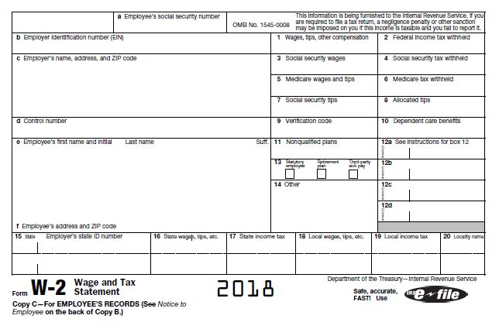
Chapter 24 Independent Contractor or Employee

Slide 71
Statutory Employees
Chapter 24 Independent Contractor or Employee
Who are they:
Drivers distributing beverages, meat vegetables, fruits, bakery products, laundry or dry cleaning
Life insurance agents full time - primarily for one company
Home workers
Travelling sales agents

Slide 72
Statutory Nonemployees
Chapter 24 Independent Contractor or Employee
Who are they:
Workers paid relative to their sales
Perform under a written contract
Must be a direct seller
Licensed real estate agents
Licensed real estate appraisers

Slide 73
Can Worker Receive Both W2 and 1099
Chapter 24 Independent Contractor or Employee
IRS has a bias against “dual service”
Some exceptions:
Officer (W2) and director (1099)
Officer (W2) and salesman (1099)
Real Estate Agent (1099) and bookkeeper (W2)

Slide 74

Chapter 24 Independent Contractor or Employee
It’s not a matter of choice
  Even if both the employer and the worker are in agreement
  Remember: a HIPPO is always a HIPPO no matter how you dress it up!!
It’s a matter of facts and circumstances

Slide 75
Chapter 24 Independent Contractor or Employee
THE REAL ISSUE, FOR MOST OF OUR CLIENTS?

Slide 76

Chapter 24 Independent Contractor or Employee
Just how much do you LUV your employees?!

Slide 77
Chapter 24 Independent Contractor or Employee
One last CYA recommendation
Do not attempt to help a client in this situation without the help of an expert attorney.

Slide 78
END OF CHAPTER!!

Slide 79
Chapter 25
Self-Employment Tax
407
Presented by:
Michael A. Gordon, CPA
Not Your Basic Bean Counter
Gear Up Tax Seminars

Slide 80
IRC 1402
Where all the action is!
Chapter 25 SE Tax
IRC 1402 is the ONLY place on the planet that tells us what income is subject to SE.
It does this by telling us what is NOT subject to SE.
It is, basically, a laundry list of “stuff” that is NOT subject to SE. Currently, that list contains 17 items.

Slide 81
Chapter 25 SE Tax
Earned income received from an isolated or sporadic activity that differs from the taxpayer's regular trade or business is generally not subject to self-employment (SE) tax because it does not rise to the level of a trade or business.
See the case on pages 408-409.

Slide 82
IRC 1402
Where all the action is!
409
Chapter 25 SE Tax
When you have rental income on Schedule E, why is it that you do NOT carry that income back to a Schedule SE?
ANSWER: Solely because IRC 1402(a)(1) specifically excludes such income from the SE tax.

Slide 83
410
Chapter 25 SE Tax
IRC 1402
Where all the action is!
When you have interest and dividend income reported on Schedule B, why is it that you do NOT carry that income back to a Schedule SE?
ANSWER: Solely because IRC 1402(a)(2) specifically excludes interest and dividend income from SE tax.

Slide 84
IRC 1402
Where all the action is!
410
Chapter 25 SE Tax
When you have capital gains reported on Schedule D, why is it that you do NOT carry that income back to a Schedule SE?
ANSWER: Solely because IRC 1402(a)(3) specifically excludes capital gain income from SE tax.

Slide 85

Recommended FUN Activity
Chapter 25 SE Tax
Take a lunch period and READ IRC 1402 with your staff. FUN, FUN, FUN….

Slide 86
Embarrassing Confession
Chapter 25 SE Tax
For years I have taught ways to “save” FICA tax.
As I get older, I am not so sure it was the wisest advice to give.

Slide 87
Embarrassing Confession
Chapter 25 SE Tax
I have always just assumed that this is what every taxpayer wants to do.
WRONG!!

Slide 88
WARNING: CYA
Chapter 25 SE Tax
True story: An attorney told us about a case where a CPA was sued for being too aggressive with the husband (sole shareholder of an S corp).

Slide 89
SE Issue: LLC Members Taxed As Partners
Chapter 25 SE Tax
Turn to pages 412-414 in the manual.
This is where so many practitioners have problems.

Slide 90
Polling Question
For 2018, the SE issue for LLC members….
Has been fully clarified.
Remains clear as MUD.
Makes me want to sell yogurt instead.
Will make taxes great again.
Notes:
INSTRUCTOR – CPE HOUR #3 – ELEMENT OF ENGAGEMENT – Perform informal poll (e.g. show of hands) by inquiring of participants – see slide content.
The correct answer is “B,” $127,200. Note that the current projection for 2018 SSA maximum taxable earnings are $130,500.

Slide 91
END OF CHAPTER!!

Slide 92

Chapter 26
Business Use of Home
Pg. 385
Chapter 27
Household Employees and Payroll
I will NOT be covering these chapters….
Gear Up Tax Seminars

Slide 93
END OF CHAPTER!!

Slide 94
Chapter 28
Sale of Business Assets
427
Presented by:
Michael A. Gordon, CPA
Not Your Basic Bean Counter
Gear Up Tax Seminars

Slide 95
Chapter 28 Sale of Business Assets
Some things to always be aware of:
Capital gain treatment is ordinary to extent of “net ordinary losses” for most recent 5 years.
See item D, page 398…and item F.5., pg 399

Slide 96
Chapter 28 Sale of Business Assets
Some things to always be aware of:
IRC 1245 recapture IN THE YEAR OF SALE. This includes purchased goodwill that is on the books being amortized.
IRC 197 assets are always treated as ONE asset. This is very important.
See Example 6 on page 432

Slide 97
Chapter 28 Sale of Business Assets
Some things to always be aware of:
When selling/buying a business, both parties should agree on allocation of purchase price.
My preference: put it in the purchase agreement document.

Slide 98
Chapter 28 Sale of Business Assets
Some things to always be aware of:
If installment sale, you MUST be involved at start of the process and calculate how much down payment is needed (minimum) to make it work. THIS GETS MISSED TOO OFTEN!!

Slide 99
Chapter 28 Sale of Business Assets
As we get older (or, as our clients get older) we will find ourselves more and more involved in consulting regarding the sale of their businesses.
Be involved with the attorney from the start
Review the documents (and do NOT be shy about CHARGING for this!)
Don’t play “valuation expert”! Dangerous!! Story of my quick print client.

Slide 100

Chapter 28 Sale of Business Assets
As we get older (or, as our clients get older) we will find ourselves more and more involved in consulting regarding the sale of their businesses.
Insist on being the one who will put forth the initial allocation recommendation. MY VERY SHOCKING DISCOVERY…NO PUSHBACK!
Horrible Update: I recently had my FIRST pushback from another CPA in my town regarding a trucking business one of my clients was selling.

Slide 101
END OF CHAPTER!!

Slide 102
Chapter 29
Installment Sales
435
Presented by:
Michael A. Gordon, CPA
Not Your Basic Bean Counter
Gear Up Tax Seminars

Slide 103
Chapter 29 Installment Sales
The code, generally, REQUIRES the use of the installment method if the facts meet the criteria (at lease one payment is to be received after the close of the taxable year of the disposition).
But, you can elect OUT…see pg 440, Item V.
WARNING: Even when using the installment method, any ordinary recapture must be included in income in the year of sale…pg 435, I.C.
No AMT impact

Slide 104
Chapter 29 Installment Sales
Certain sales are NOT eligible to use the installment method.
Dealer dispositions (inventory items)
See page 436, Item B, 1-4.
This can cause problems for real estate dealers!

Slide 105
Chapter 29 Installment Sales
Always review Form 6252 carefully!

Slide 106
Chapter 29 Installment Sales
See page 437, Item E.5.

Slide 107
Chapter 29 Installment Sales
Special situations to note:
Selling several assets at same time…Pg 438
Sale of a business…Pg 438, Item B.
Related Party rules…Pg 438, Item C.

Slide 108
END OF CHAPTER!!

Slide 109
Chapter 30
Like-Kind Exchanges
443
Presented by:
Michael A. Gordon, CPA
Not Your Basic Bean Counter
Gear Up Tax Seminars

Slide 110
Chapter 30 Like-Kind Exchanges
What’s New
  TCJA now limits 1031 transactions solely to real property exchanges where the real property is NOT held primarily for sale.
  Thus, no more 1031 exchanges for personal property.
  Where will this hit YOU AND ME the most?
  VEHICLE TRADE-INS!

Slide 111
Chapter 30 Like-Kind Exchanges
Remember: inventory does NOT qualify for 1031 treatment.

Slide 112
Chapter 30 Like-Kind Exchanges
How this “inventory” thing can potentially hurt you.
Listen to my true story of what happened to one of my larger contractor clients who exchanged a lake house (a rental house) for a 20 acre parcel of land that he would be developing. Fortunately for him…a happy ending!!

Slide 113
Chapter 30 Like-Kind Exchanges
When discussing 1031 with a client
First, is the gain large enough to make it worth considering a 1031?
Second, do the “quick BOOT” analysis.
Third, make sure the client will use a GOOD qualified intermediary.
Then….CYA documentation!!

Slide 114
Chapter 30 Like-Kind Exchanges
Real Estate Exchanges…
A GREAT lobby in Congress!
See pg. 444, Item III.A.
But remember, real estate CAN be inventory in some hands!! See pg. 444, Item III.F.

Slide 115
Chapter 30 Like-Kind Exchanges
Real Estate Exchanges…
See pg. 444, Item III.G…..so, you CAN’T exchange an apartment building in New York for one in Russia!
Debt can really “muck” things up….can lead to BOOT. See pg. 445, Item D.

Slide 116
Chapter 30 Like-Kind Exchanges
Real Estate Exchanges…
The BASIS and HOLDING PERIOD rules can be burdensome and complicated.
Be sure to read pages 447-449

Slide 117
Chapter 30 Like-Kind Exchanges
Real Estate Exchanges…
Regarding depreciation, be certain to differentiate between….
Exhange Basis Amount
Excess Basis Amount
Pages 449-450

Slide 118
Chapter 30 Like-Kind Exchanges
Vacation Home Exchanges…
Generally do NOT qualify
See pg. 451, Item VII. A. & B.
But, Rev. Proc 2008-16 gave us a bit of relief in the form of a SAFE HARBOR…see pg. 451, Item VII.D

Slide 119
Chapter 30 Like-Kind Exchanges
Related Party Exchanges…
Pg. 452, Item VIII
Must pay attention to the 2 year rule

Slide 120
Chapter 30 Like-Kind Exchanges
“Reverse” Exchanges…
Pg. 452, Item IX
Must pay attention to the 45 day and 180 day rules…pg 453, Item C.
Note the TIP box in middle of pg 453.
Most QI’s will charge more for a “Reverse” exchange.

Slide 121
Chapter 30 Like-Kind Exchanges
Regarding “qualified intermediaries”
Always recommend that our clients use a good professional QI.

Slide 122

Chapter 30 Like-Kind Exchanges
Regarding “qualified intermediaries”
Bankrupt QI’s?! Oh, my! Years ago, there were a slew of QI’s going belly up.
Why were they going belly up?
Day Trading!!!!

Slide 123
END OF CHAPTER!!

Slide 124
Chapter 31
Alternative Minimum Tax
457
Presented by:
Michael A. Gordon, CPA
Not Your Basic Bean Counter
Gear Up Tax Seminars

Slide 125
Chapter 31 AMT
What’s New
  TCJA repealed the corporate AMT, but not the individual.
  Individual exemption amounts were increased….not a lot.

Slide 126
458
Chapter 31 AMT
  For MFJ or Surviving Spouse
  From $84,500 to now $109,400
  For Single Filers
  From $54,300 to now $70,300

Slide 127

Alternative Minimum Tax
Chapter 31 AMT
How to explain it to clients

Slide 128
Alternative Minimum Tax
Chapter 31 AMT
Page 459, Item V.B.
ISO stuff!!

Slide 129
Alternative Minimum Tax
Chapter 31 AMT
Page 459, Item V.G.
Always print the Form 6251

Slide 130
Chapter 31 AMT
Biggest mistake you can make
I know, because I did this…and paid for it!!
NOT “running the numbers”
in your tax software’s planner module.

Slide 131

Polling Question
An individual taxpayer computes (and reports) AMT on IRS Form ________.
Form 6251
Form 2553
Form 3115
Form 1065
One of the new postcards
Notes:
INSTRUCTOR – CPE HOUR #4 – ELEMENT OF ENGAGEMENT – Perform informal poll (e.g. show of attendees’ hands) by inquiring of participants – see slide content.
The correct answer is “A,” Form 6251, Alternative Minimum Tax – Individuals.

Slide 132
END OF CHAPTER!!

Slide 133
Chapter 32
IRC Sec. 199A - QBID
429
Presented by:
Michael A. Gordon, CPA
Not Your Basic Bean Counter
Gear Up Tax Seminars

Slide 134
Chapter 32 IRC Sec.199A - QBID
The Qualified Business Income Deduction (QBID)
This is the BIG stuff!!!!

Slide 135


Chapter 32 IRC §199A - QBID
IT’S NOT REALLY THAT BAD!!

Slide 136

Chapter 32 IRC §199A - QBID
NEWS FLASH - JULY 2019
New Forms 8995 AND 8995-A released in DRAFT form for 2019 QBID calculation
On sale right now in the lobby for only $55 each….for a limited time only!!!

Slide 137
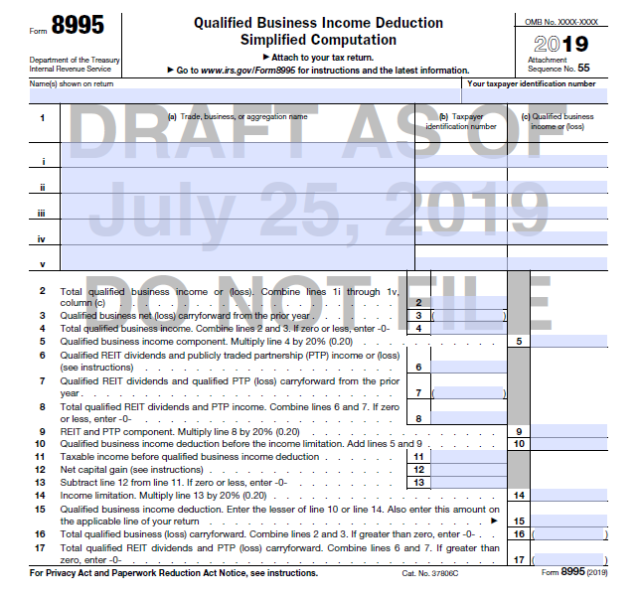
Chapter 32 IRC §199A - QBID
Form 8995

Slide 138
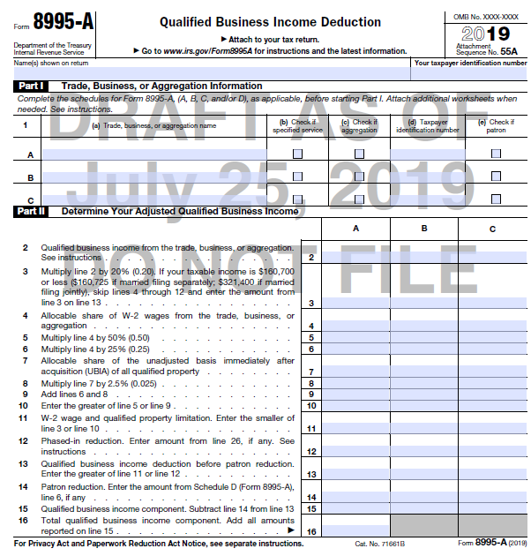
Chapter 32 IRC §199A - QBID
Page 1
Form 8995-A

Slide 139
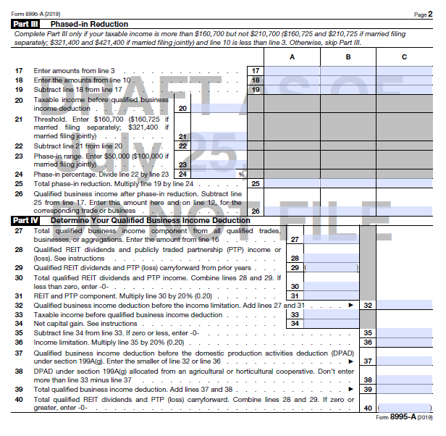
Chapter 32 IRC §199A - QBID
Page 2
Form 8995-A

Slide 140
Chapter 32 IRC §199A - QBID
Before getting into the chapter itself, I want to go over some preliminary items with you.

Slide 141
Chapter 32 IRC §199A - QBID
WARNING: You will see the following words used throughout the text of the new law…..
REFORM
SIMPLIFICATION
These words are strictly for the ignorant! Do NOT believe them….the only thing you need to remember is:

Slide 142
Chapter 32 IRC §199A - QBID
This tax act is “G.F.E.”
Guaranteed Full Employment!!!

Slide 143


Chapter 32 IRC §199A - QBID
LOVE THE HUNT !!!

Slide 144

Chapter 32 IRC §199A - QBID
WARNING:
Do NOT stick your head in the sand and say “I don’t need to learn this new tax law until later.”

Slide 145
Chapter 32 IRC §199A - QBID
BEWARE THE DISPARITIES !!
I have been teaching this all over the country.
I have attended over 10 webinars taught by top tax attorneys and CPAs.
I subscribe to several top level tax newsletters.
Regarding sound tax advice, as it relates to the new tax law, the disparity I am seeing from these sources is ASTOUNDING.

Slide 146
Chapter 32 IRC §199A - QBID
BEWARE THE DISPARITIES !!
Disparities I am witnessing….
We are now done with S corporations.
Everyone should become a C corporation.
Everyone should become a sole proprietor.
Every multi-member LLC or partnership should immediately suspend “guaranteed payments” and, instead, begin special allocations to the members/partners in the same amount.

Slide 147
Disparities in understanding, when dealing with new laws, are…
Beautiful
Just differences of opinion
Crazy people saying crazy things
All of the above

Slide 148



Chapter 32 IRC §199A - QBID
IRC 199 versus IRC 199A
Some interesting facts…RC 199 vs IRC 199A
The new QBI rules are enacted under IRC 199A (a new code section).
Do you remember the “old” IRC 199? It was the DPAD rules….one of the best deductions ever invented! It got repealed with TCJA.

Slide 149
Chapter 32 IRC §199A - QBID
IRC 199 versus IRC 199A
Some interesting facts…RC 199 vs IRC 199A
Under the DPAD rules you got a certain % (9%) of qualifying income as an additional deduction on page 1 of the 1040.
Under TCJA you also get a certain % (20%) of qualifying income as an additional deduction on the 1040.

Slide 150
Chapter 32 IRC §199A - QBID
IRC 199 versus IRC 199A
Some interesting facts…RC 199 vs IRC 199A
Under the DPAD rules architects and engineers succeeded in getting a special “carve out” and, thus, were allowed to participate. Strong lobby!!
Under TCJA, architects and engineers got a special “carve out” and are NOT considered an SSTB…so, they get away with murder. Strong lobby!!

Slide 151
Chapter 32 IRC §199A - QBID
IRC 199 versus IRC 199A
Some interesting facts…IRC 199 vs IRC 199A
Under the DPAD rules the calculated deduction was subject to a 50% wage limitation test which applied to first dollar.
Under TCJA, there is also a 50% wage limitation test (a bit different, but not by much) after crossing a certain threshold.

Slide 152
Chapter 32 IRC §199A - QBID
This is how I remember the main issues….an “OVERVIEW” OF THE QBID ISSUE.

Slide 153


QBID – The “Zones” Model
OZONE
SSTB
MFJ T.I. $415,000…..Other $207,500
TWILIGHT ZONE
Non-SSTB
Wage
Limitation
Applies
SSTB
Wage
Limitation
Applies
MFJ T.I. $315,000…..Other $157,500
GROOVY ZONE
Taxable
Income
Limitation
Applies

Slide 154

Chapter 32 IRC §199A - QBID
OKAY….LET’S LOOK AT THE BIG ELEPHANT IN THE ROOM!!!!

Slide 155
Chapter 32 IRC §199A - QBID
THE BIG ELEPHANT IN THE ROOM!!!!
Rental Real Estate

Slide 156
Chapter 32 IRC §199A - QBID
Embedded in the final regs was Notice 2019-7 which gave us a temporary safe harbor.

Slide 157
Chapter 32 IRC §199A - QBID
Before the safe harbor, the only way to use rental real estate toward QBI was to establish that it WAS a trade or business.

Slide 158
Chapter 32 IRC §199A - QBID
The new safe harbor (Notice 2019-7) did not change that. It only gave us another way to go if we couldn’t navigate the IRC 162 highway.

Slide 159
Chapter 32 IRC §199A - QBID
Let’s look, briefly, at what Notice 2019-7 gave us.
Pg 469, Item C.

Slide 160
Chapter 32 IRC §199A - QBID
IRS has come out with a FINAL safe harbor in Revenue Procedure 2019-38, released in September 2019.
Not in the book (obviously!!!).

Slide 161
Chapter 32 IRC §199A - QBID
Revenue Procedure 2019-38, finalized the safe harbor rule contained in Notice 2019-7.
Not in the book (obviously!!!).

Slide 162
Chapter 32 IRC §199A - QBID
Revenue Procedure 2019-38,
Para. .03 still requires a written statement, but not under “penalties of perjury”.
Appears to have a more relaxed requirement for the recordkeeping rules for independent contractors.
Gives some flexibility relating to “mixed use property”: can be a single activity or broken down into residential and commercial components.

Slide 163
Chapter 32 IRC §199A - QBID
Revenue Procedure 2019-38,
Many were concerned, with Notice 2019-7, that taxpayers were prohibited from treating commercial and residential rental properties as a single real estate enterprise.
This Rev-Proc maintains that feature.
In addition, once multiple interests are treated as a single rental real estate enterprise under the safe harbor, they must continue as such.

Slide 164
Chapter 32 IRC §199A - QBID
Revenue Procedure 2019-38,
This “ALL–OR-ONE” rule may be illustrated as follows:
All-in-One Example:
Mike owns 4 residential rentals and 3 commercial rentals in Portland, Oregon.
Under this finalized safe harbor, Mike appears to have only 4 options….

Slide 165
Chapter 32 IRC §199A - QBID
Revenue Procedure 2019-38,
All-in-One Example:
Mike appears to have only 4 options….
2 rental real estate enterprises…All 4 residential properties are one rental real estate enterprise and all 3 commercial properties are another rental real estate enterprise.

Slide 166
Chapter 32 IRC §199A - QBID
Revenue Procedure 2019-38,
All-in-One Example:
Mike appears to have only 4 options….
5 rental real estate enterprises…here, Mike treats the 4 residential properties as separate enterprises and treats the 3 commercial properties as one single enterprise. Thus, 5 real estate enterprises.

Slide 167
Chapter 32 IRC §199A - QBID
Revenue Procedure 2019-38,
All-in-One Example:
Mike appears to have only 4 options….
4 rental real estate enterprises…here, Mike treats the 4 residential properties as ONE enterprise and treats the 3 commercial properties as separate enterprises.

Slide 168
Chapter 32 IRC §199A - QBID
Revenue Procedure 2019-38,
All-in-One Example:
Mike appears to have only 4 options….
7 rental real estate enterprises…here, Mike treats the 4 residential properties as separate enterprises and also treats the 3 commercial properties as separate enterprises.

Slide 169
Chapter 32 IRC §199A - QBID
Revenue Procedure 2019-38,
PLEASE NOTE:
If similar properties are treated as a single real estate enterprise, newly acquired similar properties (residential or commercial) must be added to the existing rental real estate enterprise if under the safe harbor.

Slide 170
Chapter 32 IRC §199A - QBID
Revenue Procedure 2019-38,
PLEASE NOTE:
The Rev-Proc does not allow a single rental real estate enterprise to consist of interest in properties that are not similar properties and requires ALL similar properties (res. or commercial) to be treated either as separate rental real estate enterprises or as a single rental real estate enterprise.

Slide 171
Chapter 32 IRC §199A - QBID
Revenue Procedure 2019-38,
Let’s apply the last few slides to Mike’s situation…..
Mike may NOT group less than all (2 or 3) of the 4 residential properties.
Mike may NOT group less that all (i.e. 2) of the 3 commercial properties.

Slide 172
Chapter 32 IRC §199A - QBID
Revenue Procedure 2019-38,
Let’s apply the last 2 slides to Mike’s situation…..
If Mike buys another residential rental, then under option 1 or 3 (if he continued to rely on the safe harbor) he must treat it as part of the existing residential rental real estate enterprise.

Slide 173
Chapter 32 IRC §199A - QBID
Revenue Procedure 2019-38,
Mixed-Use Property
Clearly defined as a “single building that combines residential and commercial units”.
The Rev-Proc provides that an interest in a single mixed-use property may be treated as a single real estate enterprise or it may be bifurcated into separate residential and commercial enterprises.

Slide 174
Chapter 32 IRC §199A - QBID
Revenue Procedure 2019-38,
Mixed-Use Property
However, if it is treated as a single rental real estate enterprise, it may NOT be combined with ANY other residential, commercial or mixed-use property. In other words, no further grouping is allowed.

Slide 175
Chapter 32 IRC §199A - QBID
Revenue Procedure 2019-38,
Mixed-Use Property question…
The rule on the prior slide leaves us with an interesting question that is not directly addressed in the Revenue Procedure.

Slide 176
Chapter 32 IRC §199A - QBID
Revenue Procedure 2019-38,
Mixed-Use Property question…
Mike owns a large, 5 story building in downtown Portland. It has ground floor commercial units and residential units on the upper 4 floors. If Mike bifurcates the mixed-use property, as allowed under this new Rev-Proc, can he or must he group it with an existing residential or commercial enterprise?

Slide 177
Chapter 32 IRC §199A - QBID
Revenue Procedure 2019-38,
Mixed-Use Property question…
Some authors feel that the rules for “similar” properties apply and, thus, the commercial piece could comprise a portion of a commercial rental real estate enterprise…and the residential piece could comprise a portion of a residential rental real estate enterprise.

Slide 178


Chapter 32 IRC §199A - QBID
Revenue Procedure 2019-38,
That wasn’t so bad, was it?

Slide 179

Chapter 32 IRC §199A - QBID
Revenue Procedure 2019-38,

Slide 180
Chapter 32 IRC §199A - QBID
Revenue Procedure 2019-38,
Some real estate interests do NOT get to use the safe harbor…oh, bummer!!
Property leased under a “triple net lease”….remember TIM (taxes, insurance, maintenance)
Real estate used by the taxpayer as a residence under IRC 280A(d)

Slide 181
Chapter 32 IRC §199A - QBID
Revenue Procedure 2019-38,
Some real estate interests do NOT get to use the safe harbor…oh, bummer!!
Real estate rented to a trade or business conducted by the taxpayer or an RPE which is commonly controlled.
The entire property if any portion is treated as an SSTB.

Slide 182
Chapter 32 IRC §199A - QBID
Revenue Procedure 2019-38,
Some real estate interests do NOT get to use the safe harbor…oh, bummer!!
Remember, just because the prior 4 real estate interests cannot avail themselves of the safe harbor does NOT mean they lose out. They may STILL be deemed to be a trade or business under IRC 162 without the safe harbor!!

Slide 183

Chapter 32 IRC §199A - QBID

Slide 184
Chapter 32 IRC §199A - QBID
Revenue Procedure 2019-38,
You will be THRILLED to know that section 5 of the Revenue Procedure is entitled “Paperwork Reduction Act”.
Here are a few things it points out…

Slide 185
Chapter 32 IRC §199A - QBID
Revenue Procedure 2019-38,
The estimated total annual reporting and recordkeeping burden is 5.5 million hours.
The estimated annual burden per respondent/recordkeeper varies from 3 to 10 hours, with an estimated average of 5 hours.

Slide 186
Chapter 32 IRC §199A - QBID
Revenue Procedure 2019-38,
The estimated number of respondents and/or recordkeepers is 1.1 million. This estimate is based on an assumption that only a portion of taxpayers and RPEs with interests in rental real estate will choose to rely on the safe harbor.

Slide 187
Chapter 32 IRC §199A - QBID
Revenue Procedure 2019-38,
Interested in voicing your outrage, frustration or anger?
Interested in asking someone some questions who might actually know some answers?

Slide 188
Chapter 32 IRC §199A - QBID
Revenue Procedure 2019-38,
If so, you are in luck!
Section 6. Drafting Information, lists the names and phone numbers of the 4 principal authors of this Revenue Procedure!

Slide 189

Chapter 32 IRC §199A - QBID
OKAY…let’s get away from the REVENUE PROCEDURE and move on to other things!!

Slide 190
Chapter 32 IRC §199A - QBID
Regarding UBIA…pgs 475-476
Now that we have actually gone through a REAL tax season (!!), did your tax software calculate the UBIA correctly?
Did any of you check?

Slide 191
Chapter 32 IRC §199A - QBID
Regarding UBIA…pgs 475-476
QUESTION: Must the asset be listed on a depreciaton detail schedule?
EXAMPLE 1: De Minimis example in the regs showed a taxpayer deducting $1,125,000 currently.
ISSUE: Can we count that toward UBIA even though it does NOT appear on any depreciation schedule?

Slide 192
Chapter 32 IRC §199A - QBID
Regarding UBIA…pgs 475-476
EXAMPLE 2: New client comes in. Has been in business for 20 years. Depreciation schedule shows 75% of the assets as fully depreciated already.
You do NOT want to input all of them individually into your tax software!!

Slide 193
Chapter 32 IRC §199A - QBID
Regarding UBIA…pgs 475-476
EXAMPLE 2 (continued….): So you put all of the fully depreciated assets on ONE LINE of the schedule!! (You’ve all done that!).
How do you account for that for UBIA? Your tax software cannot figure it out! What did you do?

Slide 194
When dealing with the UBIA rules…..
I would have made it MUCH simpler.
Nobody asked me!
What could be easier?!
All of the above.

Slide 195
Chapter 32 IRC §199A - QBID
SE Tax Reminder
Don’t forget….The QBI deduction does NOT decrease SE income.
So, if Mike has a Schedule C with $200,000 of QBI and gets the full $40,000 deduction on page 2 of the 1040, you STILL send the entire $200,000 back to Schedule SE…not $160,000.

Slide 196

Chapter 32 IRC §199A - QBID
Independent Contractor vs. Employee?
Not in Book
Interesting true story about the large medical clinic in my town. Some of my physician clients will want to “switch” and some won’t. We’ll discuss.
New proposed regs could really HURT some of my clients due to the new “former employee” rules.

Slide 197
Chapter 32 IRC §199A - QBID
Regarding SSTB’s..pgs 476-479
FIRST OF ALL…..remember the diagram.

Slide 198
QBID – The “Zones” Model
OZONE
SSTB
MFJ T.I. $415,000…..Other $207,500
TWILIGHT ZONE
Non-SSTB
Wage
Limitation
Applies
SSTB
Wage
Limitation
Applies
MFJ T.I. $315,000…..Other $157,500
GROOVY ZONE
Taxable
Income
Limitation
Applies

Slide 199
Chapter 32 IRC §199A - QBID
Regarding SSTB’s..pgs 476-479
Now, let’s go through some stuff in the book itself on pages 476-479

Slide 200
Not in Book
Chapter 32 IRC §199A - QBID
QBI….Sole Prop. Versus S Corp planning
Example 1…Sole Proprietor
Who | Mike & Rhoda
Filing Status | MFJ
QBI | $100,000 from Mike’s retail bus.
Entity | Sole Proprietor
1040 Taxable Income | $150,000
Wages Paid | $0 (no employees)
UBQBP | $0
SSTB? | No

Slide 201
Not in Book
Chapter 32 IRC §199A - QBID
QBI….Sole Prop. Versus S Corp planning
Example 1…Sole Proprietor
Calculation of QBI Deduction
$100,000 QBI x 20% = $20,000 tentative QBI deduction
Taxable income limitation: $150,000 x 20% = $30,000
Lesser of 1 or 2 = $20,000

Slide 202
Not in Book
Chapter 32 IRC §199A - QBID
QBI….Sole Prop. Versus S Corp planning
Example 2…S Corp.
Who | Mike & Rhoda
Filing Status | MFJ
QBI | $25,000 from Mike’s business
Entity | S Corp.
1040 Taxable Income | $150,000
Wages Paid | $75,000 to Mike
UBQBP | $0
SSTB? | No

Slide 203
Not in Book
Chapter 32 IRC §199A - QBID
QBI….Sole Prop. Versus S Corp planning
Example 2…S corp.
Calculation of QBI Deduction
$25,000 QBI x 20% = $5,000 tentative deduction
Taxable income limitation: $150,000 x 20% = $30,000
Lesser of 1 or 2 = $5,000

Slide 204
Not in Book
Chapter 32 IRC §199A - QBID
QBI….Sole Prop. Versus S Corp planning
Can you see that Example 1 is exactly the same as Example 2?
The only difference is that Mike took a salary of $75,000 from the S Corp, thus reducing the QBI from $100,000 (as in Example 1) to $75,000.
Compare the answers
QBI as a sole proprietor is $20,000
QBI as an S corporation is only $5,000
BIG DIFFERENCE!!

Slide 205
Not in Book
Chapter 32 IRC §199A - QBID
QBI….Sole Prop. Versus S Corp planning
Given what we are seeing, it is tempting to tell Mike that he should:
Ditch the S corporation…..or,
Keep the S corp. but reduce his wages.
At first blush, that may seen logical and correct.

Slide 206
Not in Book
Chapter 32 IRC §199A - QBID
QBI….Sole Prop. Versus S Corp planning
My personal opinion is that we need to “RUN SOME NUMBERS” to see if that really makes sense.
We need to look at ALL the taxes…in particular, we need to factor in the SE tax impact of the 2 scenarios.
Ready? Here we go!!

Slide 207
Not in Book
Chapter 32 IRC §199A - QBID
QBI….Sole Prop. Versus S Corp planning
Example 1…Sole Proprietor with SE tax
FICA on $100,000 @ 15.3% 15,300 A
Taxable income before QBI deduction 150,000
QBI deduction -20,000
Final taxable income 130,000
Tax on final taxable income (using new rates) 20,479 B
Total tax paid 35,779 A+B

Slide 208
Not in Book
Chapter 32 IRC §199A - QBID
QBI….Sole Prop. Versus S Corp planning
Example 1…Sole Proprietor with SE tax
FICA on $100,000 @ 15.3% 15,300
Taxable income before QBI deduction 150,000
QBI deduction -20,000
Final taxable income 130,000
Tax on final t.i. (using new rates) 20,479
Total tax paid (15,300+20,479) 35,779

Slide 209
Not in Book
Chapter 32 IRC §199A - QBID
QBI….Sole Prop. Versus S Corp planning
Example 2…S Corp. with SE tax
FICA on $75,000 @ 15.3% 11,475
Taxable income before QBI deduction 150,000
QBI deduction -5,000
Final taxable income 145,000
Tax on final t.i. (using new rates) 23,779
Total tax paid (11,475+23,779) 35,254

Slide 210
Not in Book
Chapter 32 IRC §199A - QBID
QBI….Sole Prop. Versus S Corp planning
Now, it is the S Corporation that is the clear winner….granted it is only a $525 difference!
OF COURSE, I DID NOT TAKE INTO ACCOUNT ANY FUTA OR OTHER SIMILAR EMPLOYER TAXES.
I am NOT trying to make a case here. I only want to point out that there are many factors at play here that we will need to take into account. Aren’t you excited?!

Slide 211
Not in Book
Chapter 32 IRC §199A - QBID
QBI….Sole Prop. Versus S Corp planning
Finally, remember that one other option was to reduce Mike’s wages, which will serve to increase QBI and, thus, increase the deduction. As his wages go down, the QBID gets bigger and wins out (over the sole prop.) even more.
Final caveat: Never forget/overlook the “reasonable compensation” issue with S corporations.

Slide 212
When dealing with entity choice for the new QBI rules it is obvious that:
It shouldn’t take more than 5 minutes to make an intelligent decision
There could be differences of opinion
This may have to be approached on a case-by-case basis….and it could take some serious time on our part to do the analysis (oh, bummer).

Slide 213
END OF CHAPTER!!

