Slide 1

2017 Gear Up
1040 Seminar – Section D
Welcome!!
Michael A. Gordon, CPA
Not Your Basic Bean Counter

Slide 2
Itemized Deductions
Chapter 32
443
Presented by:
Michael A. Gordon, CPA
Not Your Basic Bean Counter
Gear Up Tax Seminars

Slide 3
Tax Cuts and Jobs Act … Passed 12/22/17
Itemized Deductions
Standard deduction increased
Personal exemptions deduction repealed
The overall limitation on itemized deductions is repealed….the PEASE limitation.
SALT….State and Local Taxes. Now limited to $10,000 but can use for any of the items.
BIG NIGHTMARE REGARDING THE PREPAYMENT OF TAXES!!!!!!

Slide 4
Tax Cuts and Jobs Act … Passed 12/22/17
Itemized Deductions
Medical deduction NOT REPEALED (as originally drafted in the House version).
Instead, the Act lowers the 10% threshold to 7.5% for 2017 and 2018.

Slide 5
Tax Cuts and Jobs Act … Passed 12/22/17
Itemized Deductions
Mortgage interest:
For acquisition debt incurred after 12/15/2017…the $1mm limit goes to $750,000 (MFJ)…for 7 years (through 2025).
Debt incurred on or before 12/15/17 is subject to the $1mm acquisition debt limit.

Slide 6
Tax Cuts and Jobs Act … Passed 12/22/17
Itemized Deductions
Mortgage interest:
Pre 12/15/17 binding contract exception (this is a good provision because it allows a taxpayer to still access the $1mm limit)…..
This works if a taxpayer enters into a written binding contract before 12/15/17 to close on the purchase of a principal residence before January 1, 2018, and who purchases that residence before 4/1/18. You get to use the current $1mm limit.

Slide 7
Tax Cuts and Jobs Act … Passed 12/22/17
Itemized Deductions
Home equity indebtedness:
Deduction REPEALED (through 2025).
Remember the House and the Senate versions as originally drafted?
The 2 out of 5 year rule was going to be modified to 5 out of 8
The every 2 year rule was going to be modified to once every 5 years.
The CONFERENCE agreement did NOT keep these provisions.

Slide 8
Tax Cuts and Jobs Act … Passed 12/22/17
Itemized Deductions
Casualty losses repealed (through 2025), unless associated with special disaster relief legislation.
I consider this a rather large loss and will discuss it further in the casualty loss chapter (time allowing).

Slide 9
Tax Cuts and Jobs Act … Passed 12/22/17
Itemized Deductions
Charitable deductions….50% limit goes to 60% and retains the 5 year carryforward rule.
Currently, many taxpayers make a charitable contribution to a university (for example) for the RIGHT to buy sporting event tickets. They get an 80% charitable deduction for this. Now REPEALED.

Slide 10


Tax Cuts and Jobs Act … Passed 12/22/17
Itemized Deductions
You will be THRILLED to know that the $3,000 deduction for living expenses of members of Congress has been eliminated.

Slide 11
Tax Cuts and Jobs Act … Passed 12/22/17
Itemized Deductions
Miscellaneous itemized deductions are disallowed (through 2025).
It appears that this is ONLY referring to those deductions that are subject to the 2%-of-AGI floor.

Slide 12
Tax Cuts and Jobs Act … Passed 12/22/17
Itemized Deductions
Gambling Loss Limitation is Broadened.
Now, the deduction for ANY expense incurred in gambling (not just gambling losses) is limited to gambling winnings.
This provision is clearly meant to reverse the 2011 Mayo decision (the committee reports confirm this).

Slide 13
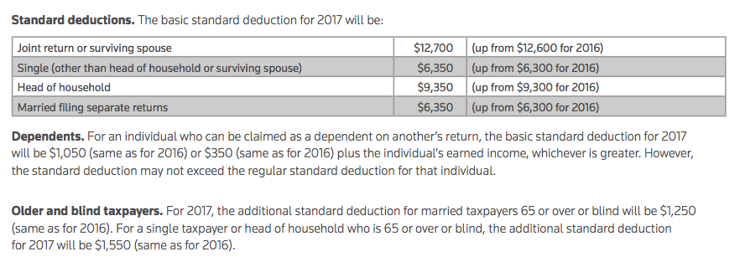
Key Developments
Page 443

Slide 14
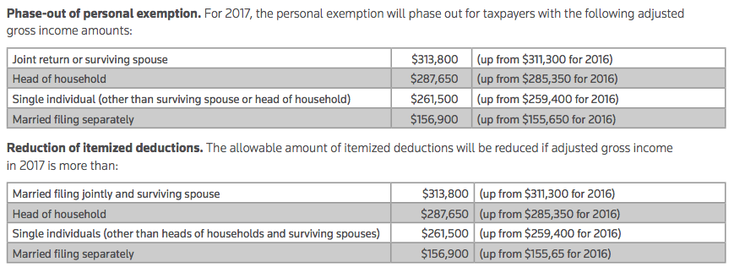
Key Developments
Page 444

Slide 15

Polling Question
It is reasonable to assume that lunch today will be _______.
Twin lobster tails
12 oz. filet mignon
Rack of lamb
Good, but none of the above ☺
Where’s the chicken?!
Notes:
INSTRUCTOR – INTRODUCTORY – ELEMENT OF ENGAGMENT – Perform informal poll (e.g. show of hands) by inquiring of participants – see slide content.

Slide 16

Key Developments
Pages 445
Medical and dental expenses
    Victoria Malev v. Comm., Docket No. 1282-16S
    Medical and moving standard mileage rate (2017) is $.17 per mile (down from $.19 in 2016).
    Beginning in 2017, 10% AGI floor applies to all taxpayers.

Slide 17

A fresh look at the “list” of qualified medical deductions. You can find this list in the Quickfinder.

Slide 18
Page 449
2017 Long-Term Care Premiums
AGE | DEDUCTION LIMIT
40 or under | $ 410
41 - 50 | $ 770
51 - 60 | $ 1,530
61 - 70 | $ 4,090
71 or older | $ 5,110
In my humble opinion, EVERYONE should have LTC insurance.

Slide 19

Key Developments
Page 452
Home mortgage insurance premiums. This provision has expired as of December 31, 2016.

Slide 20

Key Developments
Page 455
Qualified residence interest
    TC Memo 2017-70 (Wainwright)

Slide 21
Key Developments
Page 457
Qualified residence interest
    AOD 2016-02 (Voss) – IRS acquiesces to 9th Circuit ruling
This is a really good thing!!

Slide 22

Key Developments
Page 465
Charitable contributions
    TC Memo 2016-149 (Kaplanc)
    TC Memo 2017-137 (Ohde)
BIG WARNING HERE!!

Slide 23

Key Developments
Page 467
Charitable contributions
    TC Memo 2016-39 (Brown)

Slide 24
Polling Question
The Path Act made permanent the ability for taxpayers who are age 70 ½ or older to make tax-free distributions to a charity from an IRA of up to $__________ per year.
$25,000
$50,000
$100,000
$500,000
HINT: Answer is on page 462…NEW LAW box.
Notes:
INSTRUCTOR – CPE HOUR #1 – ELEMENT OF ENGAGMENT – Perform informal poll (e.g. show of attendees’ hands) by inquiring of participants – see slide content.
The correct answer is “C,” $100,000.

Slide 25
Key Developments
Page 472
Qualified conservation contributions
    Mark A. Rutkoske, Sr., et al v. Comm., 149 TC No. 6 (2017)
    TC Memo 2017-164 (310 Retail, LLC)
    Partita Partners, LLC v. U.S., 118 AFTR 2d 2016-6243
    TC Memo 2016-1 (Gemperle)
    Notice 2017-10
Notes:
INSTRUCTOR – With the exception of Notice 2017-10, these citations are NOT covered in the text. Given their more recent nature, consider discussing one or more of these with attendees in lieu of cases currently on page 472.

Slide 26
TIGTA Report
8/6/2009 – Reference # 2009-40-112
Mortgage Interest Data Could Be Used to Pursue More Nonfilers and Underreporters
Chapter 32

Slide 27
TIGTA Report
8/6/2009 – Reference # 2009-40-112
“…a large number of individuals are paying a significant amount of mortgage interest and either are not filing tax returns or are filing tax returns reporting income that is not sufficient to cover their mortgage obligations and basic living expenses. The considerable difference between income and expenditures on these returns raises serious questions about whether additional income should have been reported.”
Chapter 32

Slide 28
TIGTA Report
8/6/2009 – Reference # 2009-40-112
Overall, TIGTA estimated….
Non-filers….220k non-filers may owe $625 million.
Filers…91k filers may owe $801 million (underreported income)
Chapter 32

Slide 29
Itemized Deductions
Interest Allocation
458
Something our clients will never understand….
It is the USE of the proceeds that determines IF the interest is deductible and WHERE it is deductible.
Chapter 32

Slide 30
Itemized Deductions
Interest Allocation
459
Let’s look at the general rules (quickly) on pages 459 and 460. Then I am going to ask you a STRANGE question!!
Chapter 32

Slide 31

Itemized Deductions
Interest Allocation
459
Buried within item B. on page 459, is a deep and mysterious truth that will allow Mike to finance the purchase a brand new motorcycle…
AND DEDUCT ALL THE INTEREST as a business expense!!!
Chapter 32

Slide 32
Itemized Deductions
Charitable Deductions
465
BEWARE of the draconian rules regarding noncash contributions exceeding $5,000.
See NEW CASE box on page 465.
Chapter 32

Slide 33
Itemized Deductions
Charitable Deductions
470-472
Conservation Easement Deductions
Audit Technique Guide (revised November 2016)….89 pages.
50% limitation (100% for qualified ranchers and farmers).
Chapter 32

Slide 34
Itemized Deductions
Charitable Deductions
470-472
Conservation Easement Deductions
Notice 2017-10 issued Dec. 2016
Now a “listed transaction”
Form 8886 now required
For 2016 returns
AND for years 2014-2015
Chapter 32

Slide 35
Itemized Deductions
Charitable Deductions
470-472
Conservation Easement Deductions
Notice 2017-10 issued Dec. 2016
For 2016, due with original filed return. FILE WITH IRS.
For prior years, due date pushed out several times…ultimately due 10/2/17. FILE WITH OTSA (Office of Tax Shelter Analysis).
Chapter 32

Slide 36
Itemized Deductions
Charitable Deductions
Conservation Easement Deductions
BREAKING NEWS
Notice 2017-58 released 9/27/17. Pushes F8886 filing deadline to 10/31/17 for those impacted by hurricane Harvey, Irma or Maria.
Mark the top of the Form 8886 with “Hurricane Harvey”, “Hurricane Irma” or “Hurricane Maria”.
Chapter 32

Slide 37
Itemized Deductions
Charitable Deductions
Conservation Easement Deductions
BREAKING NEWS
Note that, based on your instructor’s reading of this IRS Notice, this only refers to the filing requirement with the OTSA. The filing requirement with the 2016 Form 1040 is still the same (i.e., filed with the 2016 Form 1040).
GOOFY INSTRUCTOR….I actually called and talked to one of the 2 authors of the IRS Notice!
Chapter 32

Slide 38

Itemized Deductions
Charitable Deductions
470-472
Conservation Easement Deductions
Notice 2017-10 issued Dec. 2016
Mike’s experience with this, recently, regarding a new client for 2016. The Form 8886 is quite a beast!
Chapter 32

Slide 40
Employee Business Expenses
Chapter 33
477
Presented by:
Michael A. Gordon, CPA
Not Your Basic Bean Counter
Gear Up Tax Seminars

Slide 41
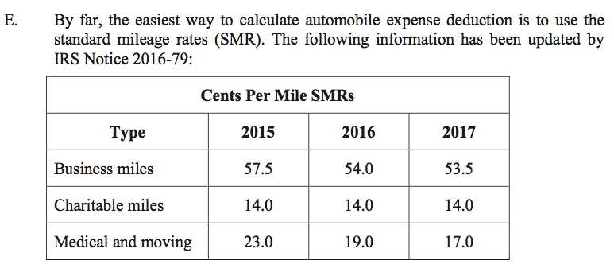
Key Developments
Page 478

Slide 42
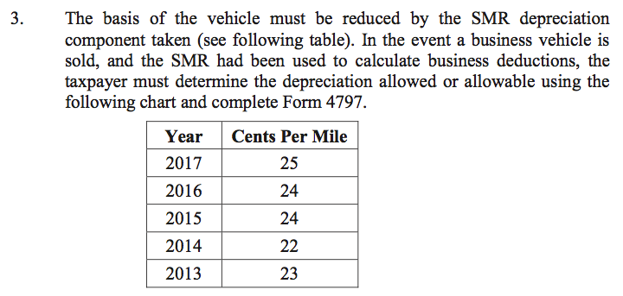
Key Developments
Page 479

Slide 43
Per Diems….great stuff!!!
Page 484
Do most of you use PER DIEMS with your clients?
Do most of YOU use PER DIEMS?
Don’t forget……you can mix and match!

Slide 44

Key Developments
Page 486
Education expenditures (more cases…not in the book!)
    LOST: TC Summary Opinion 2017-26 (Creigh) – M.B.A.
    WON: TC Summary Opinion 2016-88 (Long) – M.B.A.
    LOST: TC Memo 2016-100 (Santos) - law school tuition
    LOST: TC Summary Opinion 2016-35 (Kopaigora) – M.B.A.
Notes:
INSTRUCTOR – These citations are NOT covered in the text. Given their more recent nature, consider discussing one or more of these with attendees in lieu of case currently on page 486.

Slide 45

Lori Singleton-Clarke
A GENUINE AMERICAN HERO!!
SHE FOUGHT THE IRS AND WON…..YAY!
T.C. Summary Opinion 2009-182
This case is a GREAT read. It is very encouraging, inspiring, and motivating.
I have given it to many clients who ask me about this subject.
Notes:
INSTRUCTOR – These citations are NOT covered in the text. Given their more recent nature, consider discussing one or more of these with attendees in lieu of case currently on page 486.

Slide 47
Casualty, Disaster and Theft Losses
Chapter 34
487
Presented by:
Michael A. Gordon, CPA
Not Your Basic Bean Counter
Gear Up Tax Seminars

Slide 48
Tax Cuts and Jobs Act … Passed 12/22/17
Casualty Losses
Personal casualty and theft losses of an individual are no longer deductible UNLESS they are attributable to a federally declared disaster….through 2025.
EXCEPTION: An exception to the rule applies where the taxpayer has personal casualty gains for the tax year. Regular casualty losses, in these cases, can be offset the casualty gains.

Slide 49
Tax Cuts and Jobs Act … Passed 12/22/17
Casualty Losses
Relief for 2016 Disaster Areas
It is important to make some distinctions here. The Act itself provides several provisions regarding relief for victims of disasters that occurred in 2016. Some of the relief will be available in 2017 as well.
However, you may remember that we had several disasters in 2017 as well.

Slide 50
Tax Cuts and Jobs Act … Passed 12/22/17
Casualty Losses
Relief for 2017 Disaster Areas
For 2017 disasters, Congress passed a separate bill on 9/29/17 called the “Disaster Tax Relief and Airport and Airway Extension Act of 2017”.

Slide 51
Tax Cuts and Jobs Act … Passed 12/22/17
Casualty Losses
Rather than cover what is included in the Act itself (for 2016 disasters) I will go over the September relief bill as they are virtually identical.

Slide 52
Tax Cuts and Jobs Act … Passed 12/22/17
Casualty Losses
Revenue Procedure 2018-8 (12/13/17)
This contains safe harbor methods for determining casualty losses.
4 of the methods can be used for any casualty loss.
3 of the methods are specifically applicable only to losses occurring as a result of a Federally declared disaster.

Slide 53
Tax Cuts and Jobs Act … Passed 12/22/17
Casualty Losses
Revenue Procedure 2018-9 (12/13/17)
This contains safe harbor methods for determining casualty losses as a result of hurricanes Harvey, Irma and Maria (the 2017 hurricanes).

Slide 54

Key Developments
Page 492
Timing of deduction…very lenient. Read the case on your own time…..worth reading.
    Adkins v. U.S., 119 AFTR 2d 2017-1743 (856 F.3d 914), (CA Fed Cir), 5/8/2017

Slide 55
Key Developments
Page 493
Rev. Proc. 2016-53. IRS established procedure to address Code Sec. 165(i) election to deduct losses in presidentially-declared disaster areas.
Information to be included on statement is specified, and rules to ensure consistent treatment of losses are included in the revenue procedure.

Slide 56
Polling Question
Things to consider when choosing the tax year in which to claim a disaster loss:
Taxpayer’s need for cash
Tax bracket and taxable income (for each year)
Adjusted gross income (for each year)
Any / all of the above
HINT: Answer is on page 493…item E.
Notes:
INSTRUCTOR – CPE HOUR #2 – ELEMENT OF ENGAGMENT – Perform informal poll (e.g. show of attendees’ hands) by inquiring of participants – see slide content.
The correct answer is “D,” any or all of the above. See text page 493, E.

Slide 57
Casualty, Disaster and Theft Losses
Disaster Relief…
Congress Takes Action
9/29/17 President Trump signed H.R. 3823, the “Disaster Tax Relief and Airport and Airway Extension Act of 2017”.
Chapter 34

Slide 58
Casualty, Disaster and Theft Losses
Disaster Relief…
Congress Takes Action
For victims of Harvey, Irma or Maria.
Chapter 34

Slide 59
Casualty, Disaster and Theft Losses
“Disaster Tax Relief and Airport and Airway Extension Act of 2017”…9/29/17
Eased casualty loss rules
GOOD: Eliminates the 10% of AGI hurdle
GOOD: Eliminates current law that taxpayers must itemize deductions (so, it will increase the standard deduction for those who do not itemize)
GOOD: AMT protection for the portion of the std deduction attributable to the “net disaster loss”.
BAD: The Act increased the $100 limitation to $500.
Chapter 34

Slide 60
Casualty, Disaster and Theft Losses
“Disaster Tax Relief and Airport and Airway Extension Act of 2017”…9/29/17
Liberalized IRA and Retirement Plan Rules
GOOD: The Act allows tax-favored withdrawals from retirement plans, up to $100,000 (less any prior withdrawals treated as qualified hurricane distributions)……it does this by:
Providing an exception to the 10% penalty
Allowing the $$ to be re-contributed within 3 years from date of withdrawal
Chapter 34

Slide 61
Casualty, Disaster and Theft Losses
“Disaster Tax Relief and Airport and Airway Extension Act of 2017”…9/29/17
Liberalized IRA and Retirement Plan Rules
GOOD: Regarding plan loans, the Act increases the maximum amount that can be borrowed from $50,000 to $100,000 (again, for hurricane disaster issues). Also, the first repayment date gets extended by one year.
GOOD: Eased inclusion rule. Any income inclusion from a qualified withdrawal can be spread out over a 3-year period.
Chapter 34

Slide 62
Casualty, Disaster and Theft Losses
“Disaster Tax Relief and Airport and Airway Extension Act of 2017”…9/29/17
Liberalized IRA and Retirement Plan Rules
EXAMPLE: Mike is a victim of hurricane Irma. In October 2017 he withdraws $50,000 out of his IRA to meet living expenses. Assume the withdrawal is a “qualified hurricane distribution”. He will pay tax on that $50,000 (spread out over 3 years) but there will be NO 10% penalty. If he recontributes the $50,000 within 3 years he will file and amended return and get a refund.
Chapter 34

Slide 63
Casualty, Disaster and Theft Losses
“Disaster Tax Relief and Airport and Airway Extension Act of 2017”…9/29/17
Charitable Deduction Limitations Suspended (for hurricane relief efforts….Harvey, Irma, Maria).
“Qualified contributions” must be paid during the period beginning on August 23, 2017, and ending on December 31, 2017.
Chapter 34

Slide 64
Casualty, Disaster and Theft Losses
“Disaster Tax Relief and Airport and Airway Extension Act of 2017”…9/29/17
Charitable Deduction Limitations Suspended (for hurricane relief efforts….Harvey, Irma, Maria).
GOOD: Temporary suspension of limitations
GOOD: Eased rules for excess contributions
GOOD: Provides an exception from the overall limitation on itemized deductions.
Written acknowledgment will be required and an election needed for Act. Sec. 504.
Chapter 34

Slide 65
Casualty, Disaster and Theft Losses
“Disaster Tax Relief and Airport and Airway Extension Act of 2017”…9/29/17
Employee Retention Tax Credit for Employers
GOOD: The Act creates a brand new “employee retention credit” for “eligible employers” affected by Harvey, Irma and Maria.
“Eligible employer” = an employer conducting business in a disaster zone.
GOOD: Credit equals 40% of up to $6,000 of qualified wages.
Chapter 34

Slide 66
Casualty, Disaster and Theft Losses
“Disaster Tax Relief and Airport and Airway Extension Act of 2017”…9/29/17
Special Rule re: Earned Income (for EITC/CTC)
GOOD: The Act allows a qualified individual to substitute 2016 earned income for 2017 if 2017 earned income is lower than 2016. If this election is made it applies for EITC and CTC.
Chapter 34

Slide 67
Casualty, Disaster and Theft Losses
“Disaster Tax Relief and Airport and Airway Extension Act of 2017”…9/29/17
WARNING/DISCLAIMER
We heartily recommend that you read the actual law for yourself. The past few slides are only meant to mention the major items. There are more provisions and definitions (and exceptions) that you will need to understand.
Chapter 34

Slide 68
Casualty, Disaster and Theft Losses
487
Casualties are:
Sudden events
Unexpected events
Unusual events
Chapter 34

Slide 69
Casualty, Disaster and Theft Losses
487
You WILL want to read IRS Publication 547. It is full of good worksheets, etc.
Chapter 34

Slide 70
Casualty, Disaster and Theft Losses
In the last 2 tax years, I have had to help 3 large clients deal with multi-million dollar losses due to house fires!
I spent dozens of hours researching, calling colleagues, reading articles on internet, etc., etc.
What I learned REALLY amazed me.
Chapter 34

Slide 71
Casualty, Disaster and Theft Losses
Use a professional consultant
At the million dollar + level, you will find assets that are significantly underinsured.
Beware the ALE’s…they are usually woefully weak (e.g. only good for 12 months….never enough)
Chapter 34

Slide 72
Casualty, Disaster and Theft Losses
Gain deferral period normally 2 years past end of year of fire.
Example: Steve and Ava’s house burned down in May 2016. If they want to defer any gain they need to build the new house by the end of 2018.
Chapter 34

Slide 73
Casualty, Disaster and Theft Losses
Don’t ignore the interaction of the IRC 121 residence exclusion and the IRC 1033 deferral rule.
See EXAMPLE middle page 495.
If taxpayer is going to live in the new residence, for sure, for at least 2 years, it may be advisable to use the full IRC 121 exclusion….see next slide, too.
Chapter 34

Slide 74
Casualty, Disaster and Theft Losses
VERY LIKELY SCENARIO for a multi-million dollar home:
May not be possible to get the home built within the 2+ year time frame. This was the situation with 2 of my clients.
Here, we NEEDED to use the IRC 121 home exclusion rules!
Chapter 34

Slide 75
Casualty, Disaster and Theft Losses
Don’t overlook the obvious…..
If we are able to use the IRC 121 rules, we get a larger basis in the replacement home. With the deferral, there is no “exclusion”, only “deferral”….whereas, with the IRC 121 rule we get true “exclusion”.
Chapter 34

Slide 77
Adjustments to Income
Chapter 35
497
Presented by:
Michael A. Gordon, CPA
Not Your Basic Bean Counter
Gear Up Tax Seminars

Slide 78
Tax Cuts and Jobs Act … Passed 12/22/17
Adjustments to Income
REPEAL of exclusion for qualified moving expense reimbursements.
REPEAL of deduction for moving expenses.
REPEAL of certain deductions for employee achievement awards.

Slide 79
Tax Cuts and Jobs Act … Passed 12/22/17
Adjustments to Income
REPEAL of alimony deduction (for payor) and income inclusion (for payee). Starts in 2019.
I see no sunsetting of this!
Educator expenses. The House bill would have repealed it (the $250). The Senate bill would have doubled it to $500. The Act did nothing!! So, it stands at $250.

Slide 80
Key Developments
Page 497

Slide 81
Key Developments
Page 499
HDHP deductibles | 2018 minimum | 2018 maximum | 2017 minimum | 2017 maximum
Self | $1,350 | $ 6,650 | $1,300 | $ 6,550
Family | $2,700 | $13,300 | $2,600 | $13,100

Slide 82
Key Developments
Page 500
Maximum contribution | 2018 | 2017
Self | $3,450 | $3,450
Family | $6,900 | $6,750
55 and older | $1,000 | $1,000

Slide 83
Key Developments
Page 507
Notice 2008-1. Medical care coverage must be established by the S corporation.
    The S corporation pays the premiums for the accident and health insurance policy covering the 2% shareholder (and his spouse and dependents, if applicable) in the current tax year; or
    The 2% shareholder pays the premiums and furnishes proof of payment to the S corporation, after which the S corporation reimburses the 2% shareholder for the premium payments in the current tax year.

Slide 84

Key Developments
Page 507
Notice 2008-1. In addition, the S corporation must report the accident and health insurance premiums that are paid or reimbursed as wages on the 2% shareholder's Form W-2 in that same year.
Notice 2015-17 implications….see pg. 497 (my note)

Slide 85

497
Moving and medical mileage rate now $.17 per mile.
It just keeps getting lower and lower.
Chapter 35

Slide 86
Adjustments to Income
Chapter 35
498
HSA Question:
How many of you (or your clients) are using these? Are you finding the premiums advantageous?
Chapter 35

Slide 87
Adjustments to Income
Chapter 35
500
HSA Maximum Annual Contributions Up (a bit!)
Table top page 500
Chapter 35

Slide 88
Adjustments to Income
Chapter 35
502
Moving Expenses
Never forget Form 8822…great newsletter item.
Distance test
Time test….remember we have to “look back” to determine compliance!
Chapter 35

Slide 89
Adjustments to Income
Chapter 35
503
Moving Expenses
CYA moment….look at the cases at bottom of page. Note that the KEY issue in both cases was documentation.
First case….the lack of documentation killed the deduction.
Second case….the lack of documentation reduced the deduction from $5,000 to $3,000
Chapter 35

Slide 90
Adjustments to Income
Chapter 35
504
Moving Expenses
Meals not deductible….item E.3.
Clients love this rule!
Chapter 35

Slide 91
Adjustments to Income
Chapter 35
505
Research CYA Moment
The code and regs are NOT always in sync. Many times we find that the regs take quite a bit of time to catch up to the code.
Chapter 35

Slide 92
Adjustments to Income
Chapter 35
508
SE Health
Good EXAMPLE and NOTE on page 508
The EXAMPLE illustrates what is considered earned income.
The NOTE points out that even Medicare premiums need to added to W-2 per Notice 2008-1.
Chapter 35

Slide 94
Decedent’s Final Return
Chapter 36
513
Presented by:
Michael A. Gordon, CPA
Not Your Basic Bean Counter
Gear Up Tax Seminars

Slide 95
Tax Cuts and Jobs Act … Passed 12/22/17
Estate Tax Exclusion Increased
Increased from $5 million to $10 million.
Through 2025.
The $10 million is indexed for inflation occurring after 2011 (no typo). Thus, for 2018 the basic exclusion will be $11.2 million.
Since this is scheduled to sunset after 2025, this is going to ROCK the estate planning world!! Especially as we approach the end of 2025.

Slide 96
Tax Cuts and Jobs Act … Passed 12/22/17
Estate Tax Exclusion Increased
Interesting observation:
The House version was going to repeal the estate tax and yet KEEP THE BASIS STEP UP PROVISIONS. This surprised all of us.
This is an ongoing discussion. What will happen in 2026? Will it be extended? Brought to pre-Act limits? Repealed?

Slide 97
Decedent’s Final Return
Chapter 36
I Will NOT be covering this chapter.
However, this is a good time to discuss a practice management concept….
STICK TO THE KNITTING.

Slide 99
Foreign Income, Accounts & Credits
Chapter 37
525
Presented by:
Michael A. Gordon, CPA
Not Your Basic Bean Counter
Gear Up Tax Seminars

Slide 100
Foreign Income, Accounts & Credits
Chapter 37
525
FBAR Rules
Very interested in a show of hands here…..
How many have had clients audited by the IRS?
Penalties assessed?
Did you involve a tax attorney?

Slide 101
Foreign Income, Accounts & Credits
Chapter 37
525
Income Exclusion
How many have clients impacted by these rules?
Items II.A, B and C

Slide 102
Key Developments
Page 525
 |  | 2017 | 2016
Foreign earned income exclusion |  | $102,100 | $101,300
Foreign earned income exclusion (both spouses) |  | $204,200 | $202,600
Housing cost amount * |  | $30,630 | $30,390
* See Notice 2017-21 for the limitations on housing expenses for specific locations for 2017.

Slide 103

Key Developments
Page 528
Tax home
    In book pg 528 - TC Summary Opinion 2016-37 (Hirsch)
    Tax home in U.S. - TC Memo 2017-162 (Acone)
    Tax home in U.S. - TC Summary Opinion 2017-10 (Lock)
Notes:
INSTRUCTOR – The second and third citations are NOT covered in the text. Consider discussing one or both of these 2017 developments with attendees.

Slide 104

Key Developments
Page 528
Method of electing foreign income exclusion…item K.
    TC Memo 2017-71 (Redfield)….taxpayer lost. This is a sad case…..war veteran who suffered memory loss, etc…but it did not change the outcome.
Notes:
INSTRUCTOR – This citation is NOT covered in the text. Consider discussing this 2017 developments with attendees.

Slide 105
Key Developments
Page 533
There are two statements requiring a response in the event a taxpayer reports more than $1,500 of interest or dividends on Schedule B, Form 1040.
FinCEN Form 114, Report of Foreign Bank and Financial Accounts
Form 8938, Statement of Specified Foreign Financial Assets

Slide 106
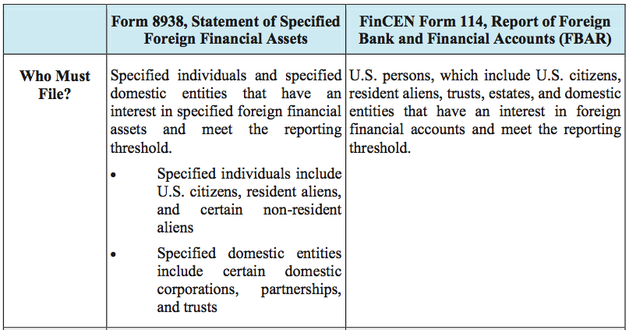
Key Developments
Page 535

Slide 107
Polling Question
If a taxpayer is required to file FinCEN Form 114, Report of Foreign Bank and Financial Accounts, they are exempt from the filing requirement for Form 8938, Statement of Specified Foreign Financial Assets.
True
False
HINT: it ain’t true!!
Notes:
INSTRUCTOR – CPE HOUR #3 – ELEMENT OF ENGAGMENT – Perform informal poll (e.g. show of attendees’ hands) by inquiring of participants – see slide content.
The correct answer is “B,” false. Each form has its filing and reporting requirements.

Slide 109
Retirement Resources
Chapter 38
541
Presented by:
Michael A. Gordon, CPA
Not Your Basic Bean Counter
Gear Up Tax Seminars

Slide 110
Tax Cuts and Jobs Act … Passed 12/22/17
Retirement Provisions – ABLE Accounts
The per-done overall limitation of $14,000 (the current gift tax exclusion amount) remains the same.
Once the above limit is reached, the Act allows contributions by the designated beneficiary…..through 2025…
Up to the lesser of (1) the federal poverty line for a one-person household (this was $12,060 for 2017), or (2) the individual’s compensation for the year.

Slide 111
Tax Cuts and Jobs Act … Passed 12/22/17
Retirement Provisions – ABLE Accounts/Saver’s Credit
There are some restrictive language in the Act regarding who is considered to be a “designated beneficiary” for this purpose.
Saver’s Credit
Prior to the Act, the saver’s credit was NOT available to an ABLE account. Now it is….but see next slide.

Slide 112
Tax Cuts and Jobs Act … Passed 12/22/17
Retirement Provisions – ABLE Accounts/Saver’s Credit
Saver’s Credit (continued)
Although anybody can contribute to an ABLE account, ONLY contributions made by the designated beneficiary qualify for the saver’s credit.
The credit is nonrefundable. So, it will only be of benefit to a designated beneficiary who has a tax liability that can be offset by the credit.

Slide 113
Tax Cuts and Jobs Act … Passed 12/22/17
Retirement Provisions – ABLE Accounts/529 Rollovers
529 plan rollovers to an ABLE account
Prior to the Act, tax-free treatment was allowed for any 529 plan distributions that, within 60 days, were rolled over into another 529 plan for the benefit of the SAME designated beneficiary OR to the credit of another beneficiary under a 529 plan who was a family member (a 10 person list).
However, no rollover provision existed allowing it to go into an ABLE account.

Slide 114
Tax Cuts and Jobs Act … Passed 12/22/17
Retirement Provisions – ABLE Accounts/529 Rollovers
529 plan rollovers to an ABLE account
Now, the Act allows such a rollover (through 2025) as long as it is to an ABLE account of the designated beneficiary or one of the 10 family members.
Observation #1: this might come in handy when a 529 beneficiary does not need the funds for qualified higher education expenses AND that beneficiary is disabled or blind and could use those funds for disability expenses.

Slide 115
Tax Cuts and Jobs Act … Passed 12/22/17
Retirement Provisions – ABLE Accounts/529 Rollovers
529 plan rollovers to an ABLE account
Observation #2: this might also come in handy when a 529 beneficiary does not need the funds for qualified higher education expenses and that beneficiary has a family member who is disabled or blind and could use those funds for disability expenses.

Slide 116
Tax Cuts and Jobs Act … Passed 12/22/17
Retirement Provisions – ABLE Accounts/529 Rollovers
529 plan rollovers to an ABLE account
Limitation (of course!): the tax-free treatment of any such rollover doesn’t apply to any portion of the rollover that exceeds the contribution limit (the annual gift exclusion).

Slide 117
Tax Cuts and Jobs Act … Passed 12/22/17
Retirement Provisions – ABLE Accounts/529 Rollovers
529 plan rollovers to an ABLE account
Limitation example: Mike receives a $10,000 distribution from a 529 plan in 2018 (when the gift tax exclusion amount is $18,000) and rolls it over right away into an ABLE account for the benefit of his niece (who is blind). Her account also received $15,000 of other contributions in 2018.
Annual limit? $18,000. Total contributions? $25,000. Therefore, $7,000 will be includible in the niece’s income.

Slide 118
Tax Cuts and Jobs Act … Passed 12/22/17
Retirement Provisions – 529 Plans
529 plan distributions
Prior to the Act: An “eligible educational institution” did NOT include an elementary or secondary school. So, distributions to cover tuition for these institutions were not tax-free.
Now, the Act includes them and allows distributions up to $10,000 per beneficiary (NOT per account…in the event one beneficiary has multiple 529 accounts) to cover tuition.

Slide 119
Tax Cuts and Jobs Act … Passed 12/22/17
Retirement Provisions – IRA recharacterizations
Current law allows us to recharacterize Roth IRA contributions and traditional IRA contributions.
Under the Act, the provisions referred to above NO LONGER apply to a conversion contribution to a Roth IRA.
So, is this a total tragedy?

Slide 120
Tax Cuts and Jobs Act … Passed 12/22/17
Retirement Provisions – IRA recharacterizations
NO…all it means is that recharacterization cannot be used to unwind a Roth conversion.
We can still…..
Contribute to a Roth IRA and, before the due date of the tax return, recharacterize it as a contribution to a traditional IRA.
Contribute to a traditional IRA and convert it to a Roth IRA….but, under the Act, you cannot later unwind it through a recharacterization.

Slide 121
Tax Cuts and Jobs Act … Passed 12/22/17
Retirement Provisions – Rollover period for loan offset amounts extended to return due date.
What is a “loan offset amount”?
Normally seen when a participant takes a loan from a qualified employer plan and then leaves that employer (or the plan is terminated) with the loan still outstanding.
Generally, at that time, the accrued benefits under the plan are reduced in order to repay the loan. This can be considered a taxable distribution if not rolled over within 60 days.

Slide 122
Tax Cuts and Jobs Act … Passed 12/22/17
Retirement Provisions – Rollover period for loan offset amounts extended to return due date.
New law….
Now, the period during which a qualified plan offset amount may be contributed to an eligible retirement plan as a tax-free rollover is extended from 60 days after the date of the official offset to the due date (including extensions) for filing the federal income tax return

Slide 123
Tax Cuts and Jobs Act … Passed 12/22/17
Retirement Provisions – Rollover period for loan offset amounts extended to return due date.
New law….continued
Observation: since the tax return due date may occur more than 60 days following the date of the offset, the Act is providing an exception to the 60-day rollover requirement by allowing tax-free rollovers of qualified plan loan offset amounts more than 60 days following the date of the offset.

Slide 124
Retirement Resources
Chapter 38
541
Item I.A. page 541….interesting stats!

Slide 125
Retirement Resources
Chapter 38
542
EXAMPLE pg. 542, last paragraph.
Anyone ever use the free calculator?

Slide 126

Key Developments
Page 545
Annuity distributions
    PLR 201625001

Slide 127
Key Developments
Page 547
Page 547, item VI.B.2
 |  | 2017
Quarter of credit earned |  | $1,300 (FICA income)
Minimum earnings for (4) quarters |  | $5,200 (FICA income)

Slide 128
Key Developments
Page 550
 |  | 2017
Year individual reaches full retirement age (FRA) and only for those months for which an individual is not actually at full retirement age for a full month |  | $44,880 / year $ 3,740 / month
For any year in which an individual does not attain full retirement, but is at least age 62 |  | $16,920 / year $ 1,410 / month

Slide 130
Retirement Savings
Chapter 39
553
Presented by:
Michael A. Gordon, CPA
Not Your Basic Bean Counter
Gear Up Tax Seminars

Slide 131
Page 553
Determine allowable IRA contributions, both traditional and Roth
Select appropriate defined contribution plans for clients
Calculate allowable contributions for owners and employees

Slide 132
Key Developments
Page 553
 |  | 2017
IRA contribution limitation |  | $5,500 *
IRA “catch-up” contribution limitation |  | $1,000 *
* Amounts remain unchanged for 2018 contributions.

Slide 133
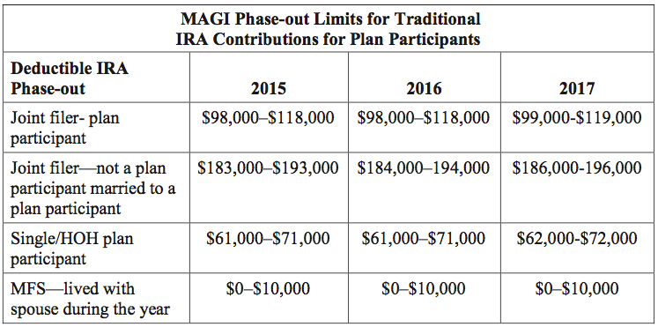
Key Developments
Page 556

Slide 134
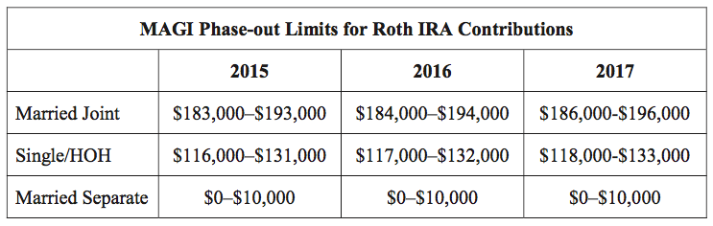
Key Developments
Page 557

Slide 135
Key Developments
Page 558
 | 2016 | 2017
SEP maximum compensation [Code Sec. 408(k)(3)(C)] | $265,000 | $270,000
SEP mandatory participation [Code Sec. 408(k)(2)(C)] | $600 | $600

Slide 136
Key Developments
Page 559
 | 2016 | 2017
Limitation on SIMPLE retirement plans [Code Sec. 408(p)(2)(E)] | $12,500 | $12,500
Age 50 “catch-up” [Code Sec. 414(v)(2)(B)] | $3,000 | $3,000

Slide 137

Key Developments
Page 560
The U.S. Department of the Treasury has decided to phase out the myRA® retirement savings program.
The program is no longer accepting new enrollments.

Slide 138
Polling Question
How many of you had a client (or multiple clients) fund a myRA account?
Notes:
INSTRUCTOR – CPE HOUR #4 – ELEMENT OF ENGAGMENT – Perform informal poll (e.g. show of attendees’ hands) by inquiring of participants – see slide content.
This polling question is subjective in nature. No correct (or incorrect) answer.

Slide 139

Key Developments
Page 561
Self-directed IRA accounts
    TC Memo 2016-28 (McGaugh)

Slide 140
Key Developments
Page 565
 | 2016 | 2017
Exclusion for elective deferrals [Code Sec. 402(g)(1)] | $18,000 | $18,000
Age 50 “catch-up” [Code Sec. 414(v)(2)(B)] | $6,000 | $6,000
Limitation – defined contribution plans [Code Sec. 415(c)(1)(A)] | $53,000 | $54,000

Slide 141
Real Estate In An IRA
How many of you have clients with real estate in their IRA?
How many of you have had clients ask about this?

Slide 142
Real Estate In An IRA
In my firm, we will NOT deal with a client who does this (shame on us!).

Slide 143
Real Estate In An IRA
Some issues of concern…
Some clients will “flip” the property. This constitutes a trade or business, which creates UBTI….BAD NEWS.
If it’s a rental and there is a loss, where do you deduct it? ANSWER: You don’t.
Personal use causes all kinds of problems. It can cause a FMV deemed distribution!

Slide 144
Real Estate In An IRA
Some issues of concern…
Has anyone found a trustee that really understands all the rules?
How do you accomplish a RMD if the only asset is real estate?
Let’s pretend that additional cash is needed to fund rental operations. How do you get that money into the IRA without triggering the excess contribution problem?

Slide 146
Retirement Account Distributions
Chapter 40
571
Presented by:
Michael A. Gordon, CPA
Not Your Basic Bean Counter
Gear Up Tax Seminars

Slide 147

Key Developments
Page 594
Rev. Proc. 2016-47 provides a self-certification waiver for failure to meet the 60-day rollover rule.

Slide 148


